Slide 1
Nurturing Spirituality
Across the Lifespan
Mary Alice Bruce, Kristina Faimon
Rebecca Attebury, Greg Sandman
Wyoming Counseling Association
Annual Conference, October 2015
Notes:
1

Slide 2

Spirituality? A sense of oneness & interconnectedness that leads
to
Authenticity
Compassion
Meaning
in and with
the universe
(Duran, Firehammer, & Gonzalez, 2008)

Slide 3
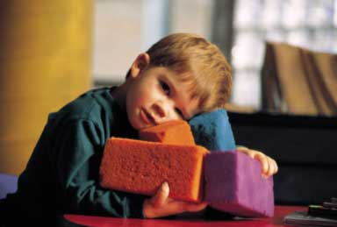
Models of Development
Faith-based models
Allport (1950)
Oser (1991)
Fowler (1991)
Genia (1995)

Slide 4

Models of Development
Spiritually based models
Jung (1933)
Wilber (1977)
Washburn (1995)

Slide 5
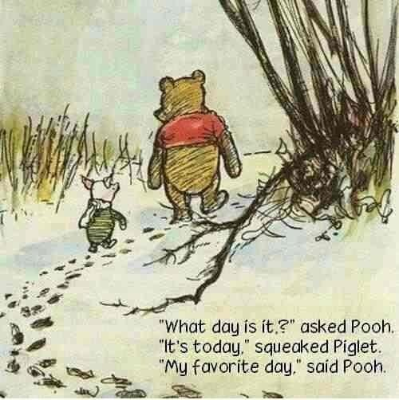
Developing a Sense of Self in Young Children

Slide 6
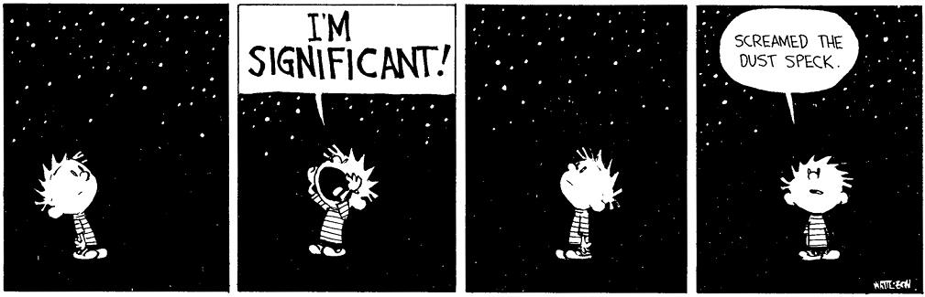
The Big Questions of a Developing Mind
Who am I?
Why am I here?
How do I cope with things too big for me?
How am I to live?
What are these feelings, and how do I make sense of them?

Slide 7
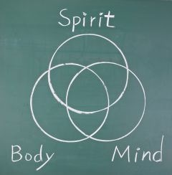
How we help answer the questions...
Spiritual Development
“Concerning matters of the soul. The exploration of the essence of being human.”
All spiritual pursuits agree that essence is in all of us.
Secular endeavour, as well as religious
Ex. Finding yourself...

Slide 8
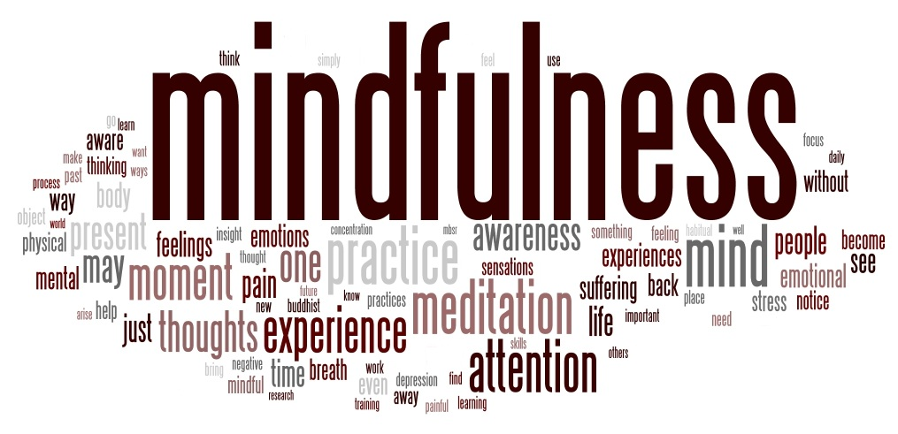
How do we get there?
Having and celebrating a relationship with yourself. Paying attention to the here and now with kindness and curiosity.

Slide 9
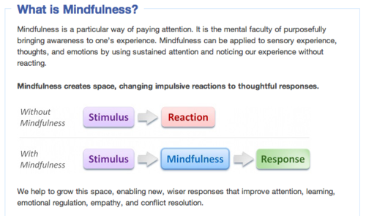
Using Mindfulness in Schools

Slide 10
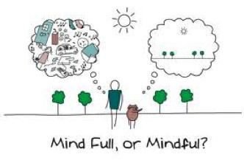
What we achieve...

Slide 11
Using Spiritual Disciplines to Enhance Mental Health
Spiritual disciplines have been a valuable part of many religious traditions both Western and Eastern for millennia.
For spiritual/religious clients incorporating these practices into their mental health routine may provide a secure and trusted means to assist in their progress.

Slide 12
Types of Spiritual Disciplines (Christian)
Inward Disciplines
Outward Disciplines
Corporate Disciplines
Meditation/Contemplation
Prayer
Study (Lectio Divina)
Fasting
Simplicity
Solitude
Submission
Service
Confession
Worship
Guidance
Celebration

Slide 13
Prayer
Prayer – various types of prayer include:
  Petition – asking for something for oneself
  Intercession – asking for something for someone else
  Confession – admitting wrongdoing and asking forgiveness
  Lamentation – crying in distress and asking for vindication
  Adoration – giving honor and praise
  Invocation – summoning the presence of a Higher Power
  Thanksgiving – offering gratitude

Slide 14

Contemplation/Meditation
Contemplation/Meditation – involves several means of gaining awareness of one’s inner thoughts and feelings
  Counting breaths
  Attending to a repeated thought
  Focusing on an internal or external stimulus
    Quotation
    Passage from a holy book
    An object that has personal meaning

Slide 15

Study
Lectio Divina (Reading Holy Writings)
  Is often associated with meditation and contemplation
  Can also be done in groups and many religious institutions use this as a form of praye.
  One reads a passage from a holy book (Bible) The person is encouraged to read a short passage, listening with their heart to what is being read or said
  The person may repeat one word or phrase over and over, contemplating it’s meaning to them in that moment
Brief use of LD – see handout
http://ocarm.org/en/content/lectio/what-lectio-divina

Slide 16

Forgiveness
Forgiveness – choosing to forgive someone for having wronged you OR choosing to forgive oneself for wrongs you have committed
  Forgiveness is a process. Often devout people try to forgive others before they have resolved important issues of hurt, shame, guilt, and boundaries
  Therapists may want to assist the client work through feelings of anger, betrayal, denial, gaining awareness that they have been hurt or abused, providing opportunities to express feelings of anger, hurt, rage, and shame
  Boundary repair may be necessary in order to ensure the abuse does not continue

Slide 17
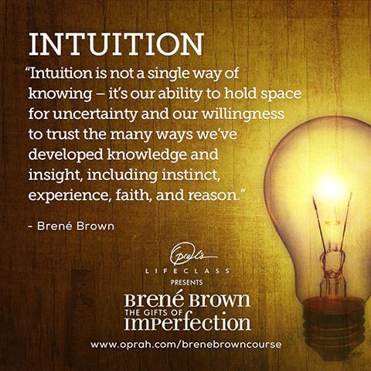
Mantra Making

Slide 18
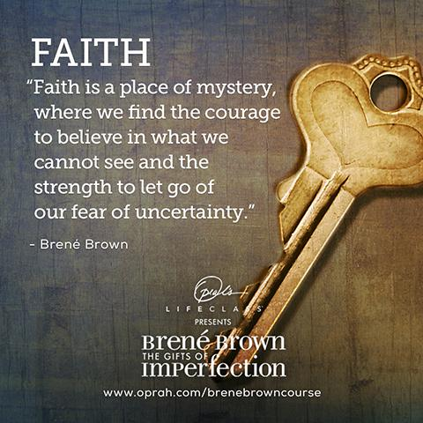

Slide 19
Further Your Understanding
Make a commitment to speak your mantra two times today or tomorrow. Pay attention to when, where and how you say it. When is it helpful? What does it do for you?
Is there a book or song that inspires you to reconnect with your faith and/or intuition?
Create some white space in your life. Put one hour of time a week on your calendar and protect it like you'd protect an important meeting or a doctor's appointment. Don't clean or work on your to-do list. Get quiet. If you feel like you're coming out of your skin, welcome to the club. It means we need more practice.

Slide 20
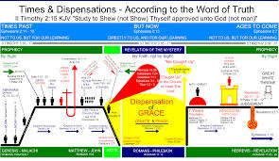
Create a Spiritual Timeline
  Defining milestones
  Rituals
  Spiritual events
  Spiritual guides
  Challenges
Notes:
20

Slide 21
Processing Timelines… listen for themes
Use of lines, shapes, language, pictures as symbols
FOA
Supportive Relationships
Power
Grief and loss
Crisis/trauma/struggle
Rebirth
Notes:
21

Slide 22
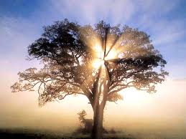
Processing continues
Freedom
Comfort
Thriving
Joy
Spiritual gifts
Ongoing contemplation & meaning making
Notes:
22

Slide 23

Your Insights to Share?
Notes:
23

