Slide 1
Wyoming Counseling Association Conference
Identifying & Supporting Students with Mental Health Disabilities
October 2, 2015

Slide 2
Identifying & Supporting Students with Mental Health Disabilities
We Need Your Help!

Slide 3
Betty Gion – School Counselor Pathfinder High School, Lander, WY
Scott Gion – Middle School Principal Wyoming Indian Middle School, Ethete, WY
Jacob Gion – Middle School Principal St. Labre Indian School, Ashland, MT
Cody Gion- School Psychologist/Doctorate Student University of Oregon, Eugene, OR

Slide 4
Facts on Children’s Mental Health in America
Prevalence:
Of children age 9-17; 21% have a diagnosable mental or addictive disorder.
Half of all lifetime cases of mental disorders begin by age 14.

Slide 5
It takes 8-10 years on average – from the first set of symptoms to when/if a student receives treatment.
In any given year, only 20% of children with mental disorders are identified and receive mental health services.
Untreated mental disorder can lead to more severe, more difficult to treat, disorders and the development of co-occurring mental illness.

Slide 6
Hmmm . . .
21 children out 100 have a mental health disorder,
it will take about 8-10 years to identify these children . . .
and in any given year only 4.2 children/100 will receive services.

Slide 7
School Failure:
56% of high school dropouts have a diagnosed mental health disorder.
Highest dropout rate of any disability group.
Top Challenges Addressed in School-Based Mental Health Services
Boys | Girls
Social/Interpersonal or family problems (66%) | Social/Interpersonal or family problems (74%)
Aggression or disruptive behaviors (54%) | Depression/grief (47%)
Alcohol/drug problems (34%) | Anxiety (36%)

Slide 8
Only 32% of students with serious mental illness continue onto postsecondary education.
64% of college students with mental-health issues drop out.
(only 7% of parents report their college students as experiencing mental health issues)

Slide 9
Suicide:
Over 90% of children/adolescents who commit suicide have a mental disorder.
3rd leading cause of death – ages 15 to 24.
The rate of suicide for children incarcerated is 4X higher than the general public.

Slide 10
Criminal Involvement:
Unidentified/untreated youth with mental disorders tragically end up in jails and prisons.
65% boys/75% girls in juvenile detention have at least one mental illness.
We are incarcerating youth living with mental illness, rather than identifying their conditions early and intervening with services.

Slide 11
References:
NAM: National Alliance on Mental Illness
The Daily Cougar – Sixty-four percent of college students with mental-health issues drop out ; Christopher Shelton, November 27, 2012
National High School Center; betterhighschools.org; July 2009

Slide 13
How Can I Affect Change?
Getting Administrators on Board.

Slide 14
3 Keys
Be Persistent
Provide Solutions
Provide Evidence/Research

Slide 15
Social Emotional Learning
www.casel.org
Positive Discipline
PBIS - Effect Size (Teacher Student Relationships) = .72 (Hattie, 2009)
Mindfulness – In patients with anxiety and mood disorders, this intervention was associated with effect sizes (Hedges’ g) of 0.97 and 0.95 for improving anxiety and mood symptoms, respectively.

Slide 16
Partnerships with Local Agencies
Local behavioral/mental health services
Youth Dynamics, Altacare, related agencies
Outside support/workshops
Key is to allow access/tap into resources

Slide 17
Academic Programs
Direct/Explicit Instruction
Effect Size = .59 (Hattie, 2009)
Reading Mastery, Corrective Math, etc.
ICU Database

Slide 19
Effects of Exclusion
Student’s with disabilities are twice as likely to be suspended than their non-disabled peers for the same behavior.
Suspensions and expulsions are linked to increased rates of future behavior problems, academic difficulty, detachment, and dropout.
Schools that suspend more have poorer school climate and lower overall academic achievement scores.

Slide 20
Support for……Support
Greeting students at the door (increases engagement by 30%)
Teaching Expectations (ES= 0.76)
Reinforcing positive behavior (ES= 1.17)

Slide 21
References:
Allan Allday, R., & Pakurar, K. (2007). Effects of Teacher Greetings on Student On-task Behavior. Journal of Applied Behavior Analysis, 40(2), 317–320. http://doi.org/10.1901/jaba.2007.86-06
FACT SHEET: School Discipline and the Pushout Problem
http://www.dignityinschools.org/files/DSC_Pushout_Fact_Sheet.pdf
Skiba, R., & Sprague J. (2008). Safety without Suspensions: http://www.pbis.org/training/coach-and-trainer
Wang, Haertel, and Walberg (1993), Toward a knowledge base for school learning. Review of Educational Research, 63(3), 249-294.

Slide 23
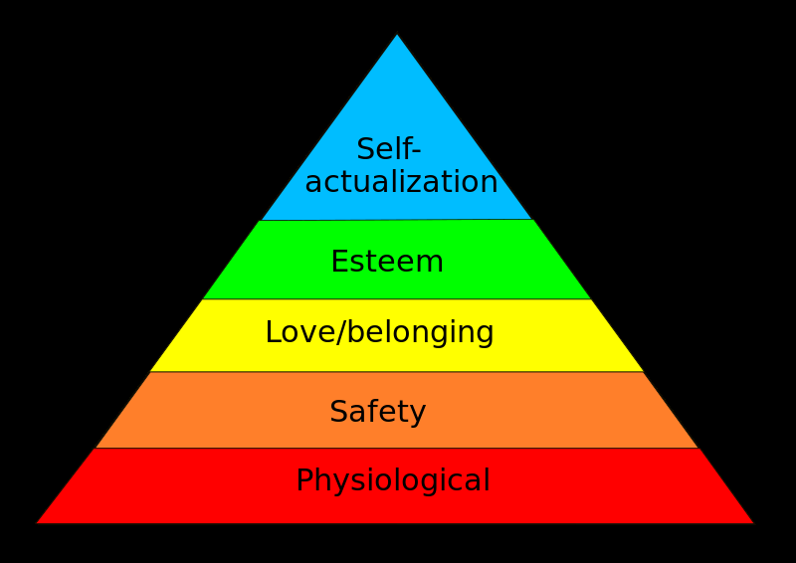
Kids Are People Too
Maslow's Hierarchy of Needs

Slide 24
"Right Here“ by Staind
I know I've been mistaken But just give me a break and see the changes that I've made I've got some imperfections But how can you collect them all and throw them in my face

Slide 25
Disconnecting Kids
and Families from the School.
Class Jobs - Privileges
Lunch and Recess
Celebrations – Incentives – Field Trips
Eligibility and Sports
Office Referrals and Suspensions
Organizations – Clubs – Dances
10 Day Drop Rule
Parents Are People Too

Slide 26
Doing Things Differently
Create healthy school cultures – Anthony Muhammad
Build student confidence through success experiences (esteem)
Connect all staff, students, and families to the school
Rewrite handbooks through the “love/belonging” lens
“If you always hope to end up loving and supporting your child, why don’t you just start there?” – Liz Davis

